Slide 1
Rhythm Boot Camp
CoLab 2024
Rhythms From the Heart Project
Trinity Laban Conservatoire
of Music and Dance
London, UK
Felice Pomeranz
felice.p23.947@edu.trinitylaban.ac.uk
Professor of Harp
Berklee College of Music
Boston, MA, USA
fpomeranz@berklee.edu

Slide 2
Rhythm Boot Camp
Felice Pomeranz

Slide 3
Rhythm Boot Camp
Felice Pomeranz

Slide 4
Rhythm Boot Camp
Felice Pomeranz

Slide 5
Rhythm Boot Camp
Felice Pomeranz

Slide 6
Rhythm Boot Camp
Felice Pomeranz

Slide 7
Rhythm Boot Camp
Felice Pomeranz

Slide 8
Rhythm Boot Camp
Felice Pomeranz

Slide 9
Rhythm Boot Camp
Felice Pomeranz

Slide 10
Rhythm Boot Camp
Felice Pomeranz

Slide 11
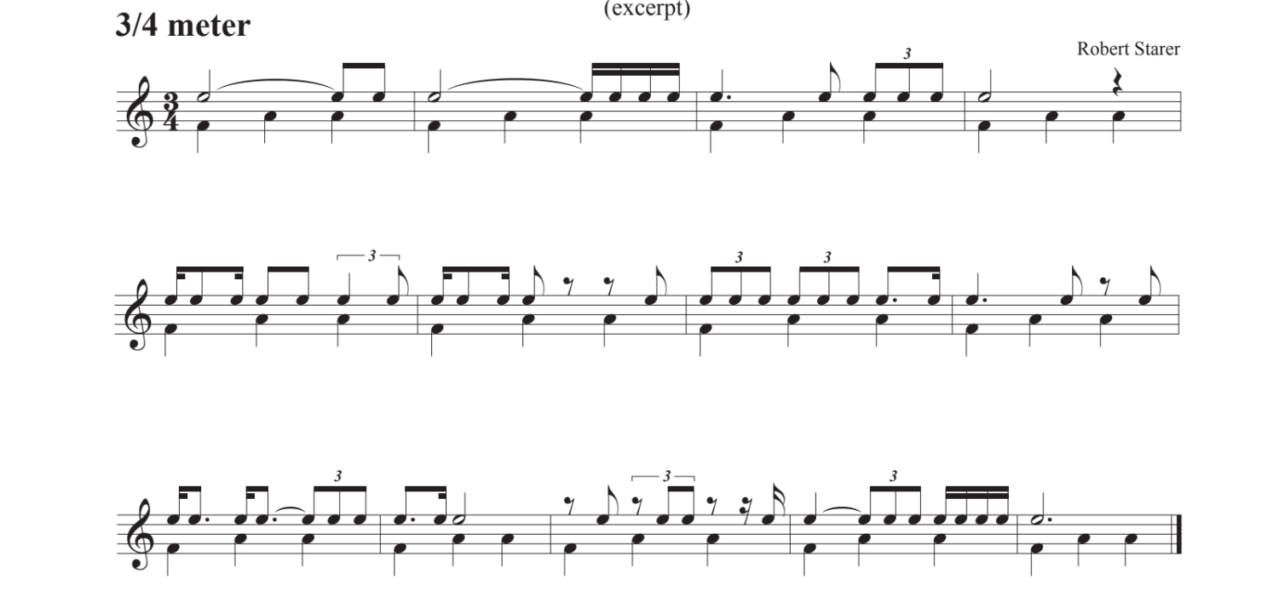
Rhythm Boot Camp
Felice Pomeranz

Slide 12
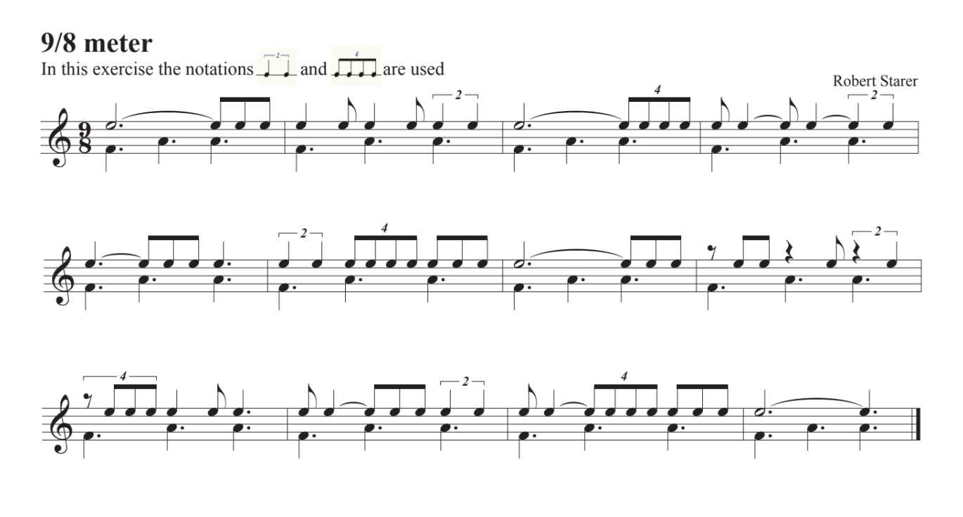
Rhythm Boot Camp
Felice Pomeranz

Slide 13
Rhythm Boot Camp
Felice Pomeranz

Slide 14
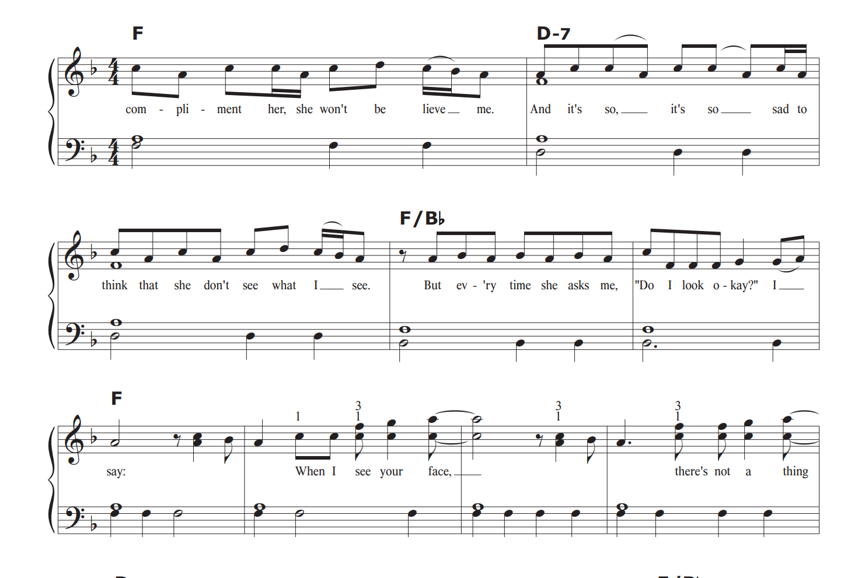
Rhythm Boot Camp
Felice Pomeranz
Just the Way You Are
Bruno Mars

Slide 15
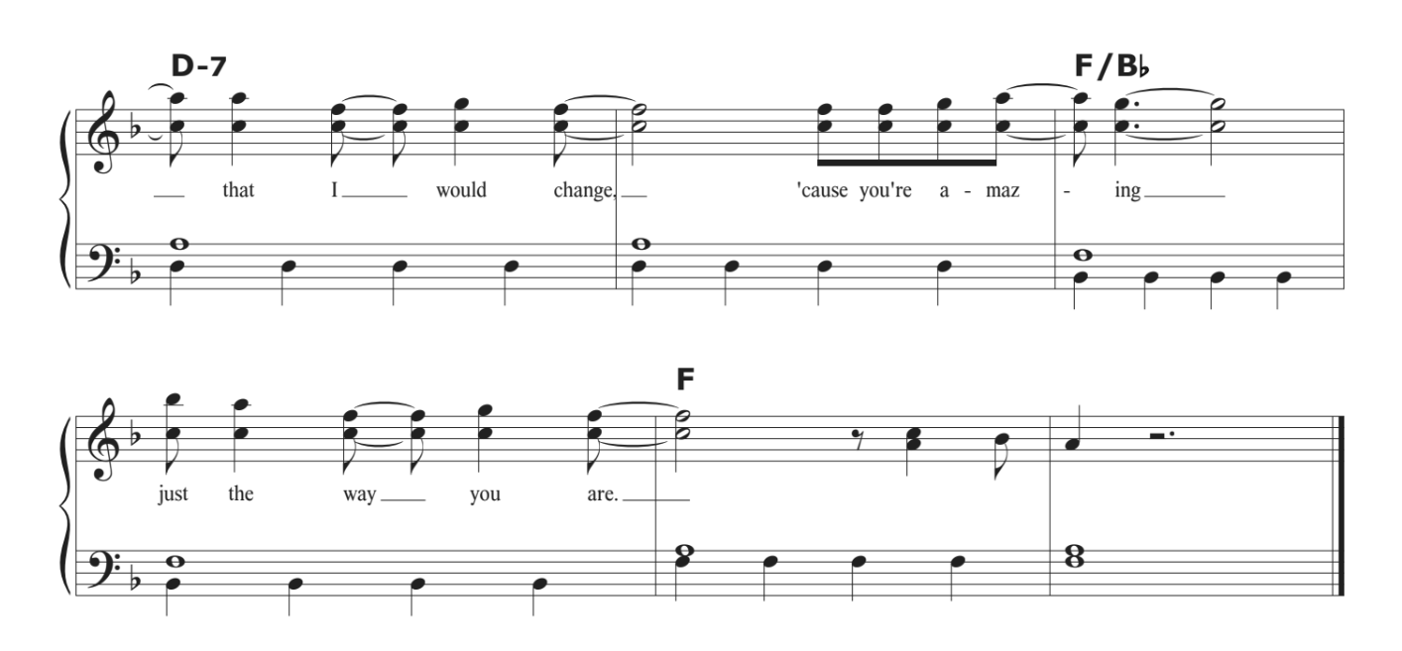
Rhythm Boot Camp
Felice Pomeranz
Just the Way You Are

